Slide 1

BREAST CANCER PREDICTION ANALYSIS
The Breast Cancer Wisconsin (Diagnostic) Dataset
By
Moulika chatu

Slide 2

OBJECTIVE
This analysis aims to observe which features are most helpful in predicting malignant or benign cancer and to see general trends.
The goal is to classify whether the breast cancer is benign or malignant.
AGENDA
Identifying the problem and Data Sources
Exploratory Data Analysis
Pre-Processing the Data
Build model to predict whether breast cell tissue is malignant or Benign

Slide 3
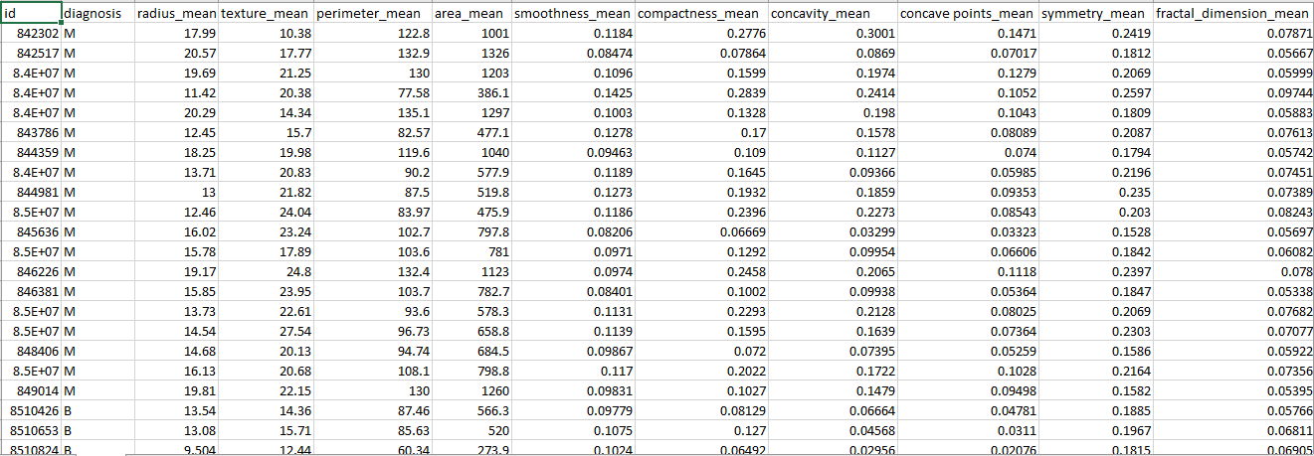
DATASET DESCRIPTION
Radius, measured from center to point of perimeter (mean, standard error, worst[highest mean])
Texture, measured by pixels making up the segmented area, is represented by grey-scale values (0 for black and 255 for white).
Perimeter, which is the size of the core tumour
Area, area of the tumour
Smoothness, measured by variation in radius length
Compactness, measured by the mean of [(square of perimeter)/area -1]
Concavity, whether it concave upwards or concave downwards
Concave point (number of concave portions)
Symmetry
Fractal dimension, which measures the complexity comparing how a detail in a pattern changes with the scale in which it is measured

Slide 4
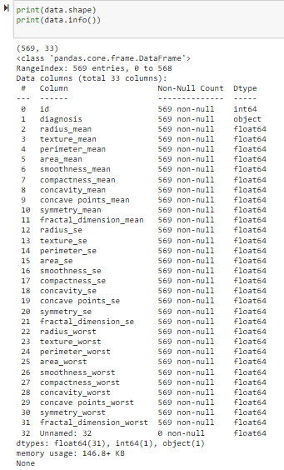
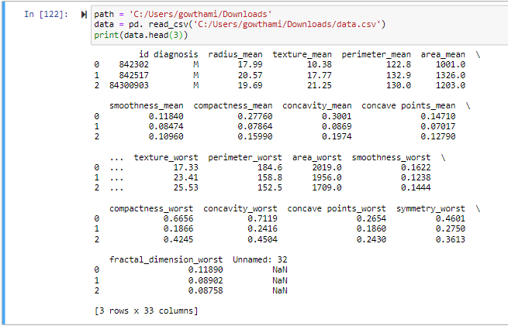
DATA CLEANING

Slide 5
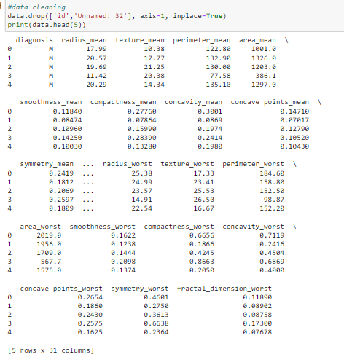
DATA CLEANING

Slide 6
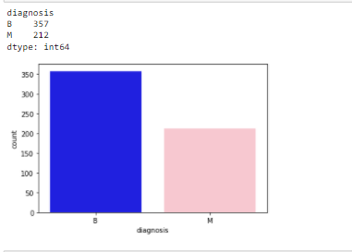
STATISTICAL ANALYSIS
Find the target variable and get the distribution(Finding the frequency of diagnosis)

Slide 7
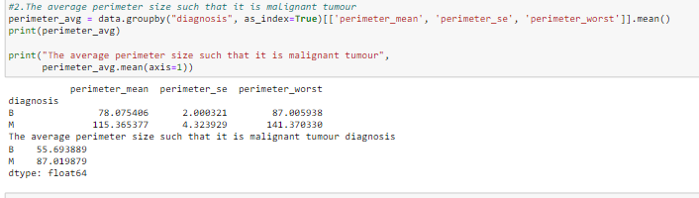
STATISTICAL ANALYSIS
What should be the average perimeter(size of the tumour cell) such that it is malignant?

Slide 8
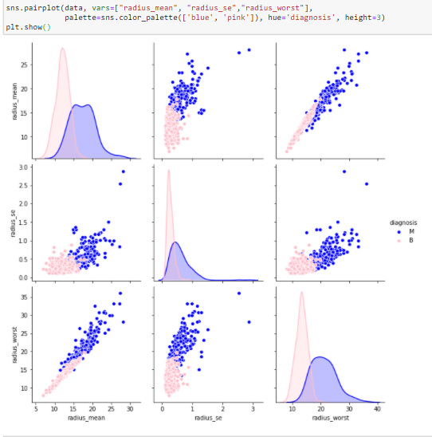
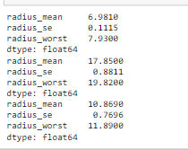
STATISTICAL ANALYSIS
At what range of radius there are more benign tumours?

Slide 9
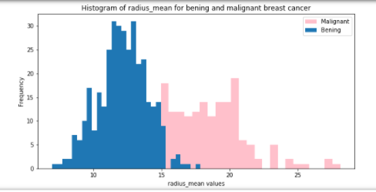
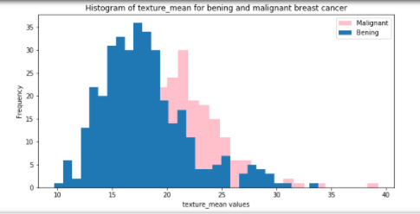
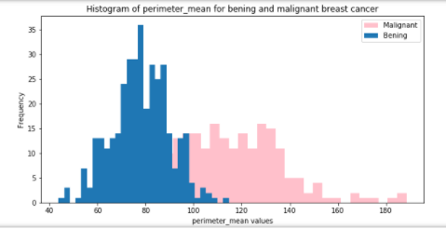
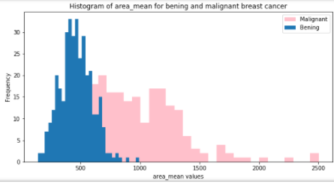
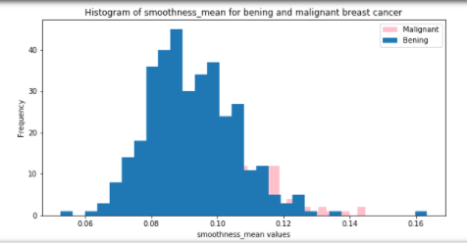
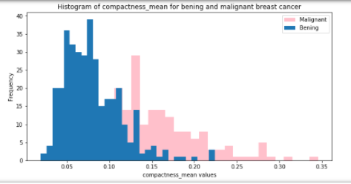
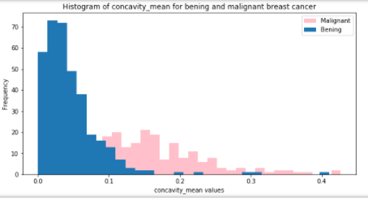
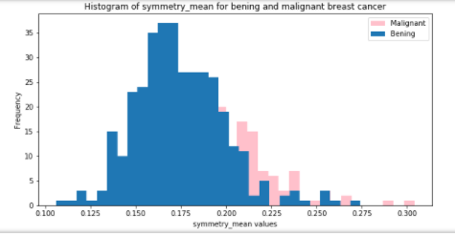
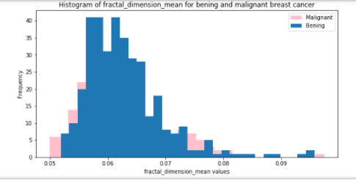
DATA VISUALIZATION

Slide 10
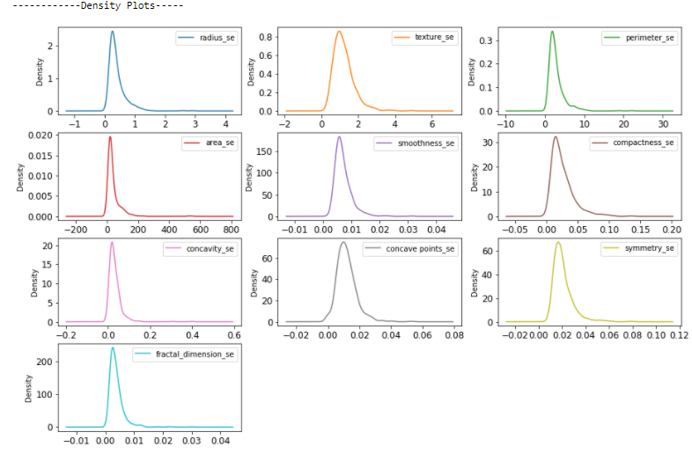
DATA VISUALIZATION
Density Plots

Slide 11
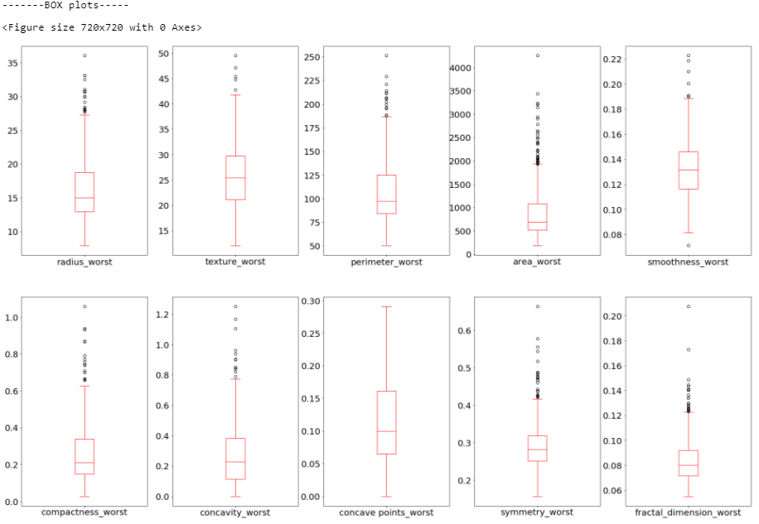
DATA VISUALIZATION
Box Plots

Slide 12
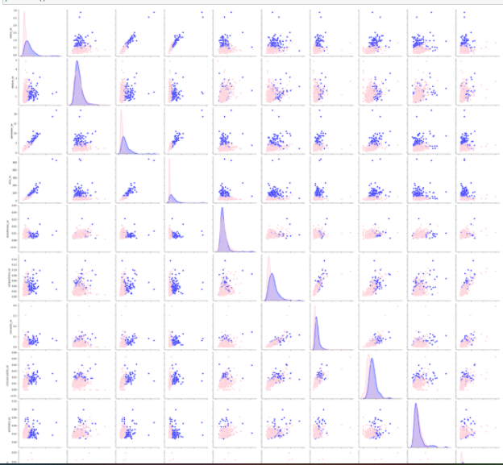
DATA VISUALIZATION
Pair wise plots

Slide 13
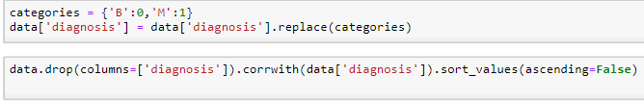
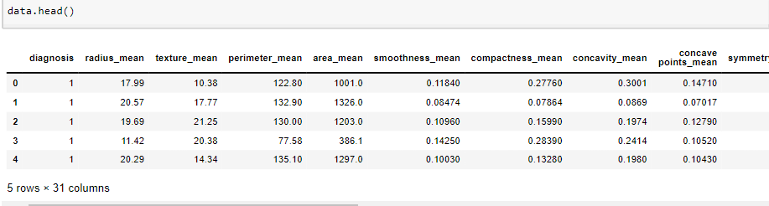
DATA ENCODING

Slide 14
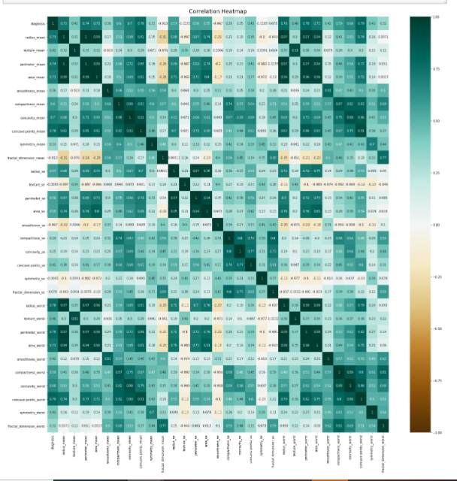
Finding Co-relation
1. using Heat map

Slide 15
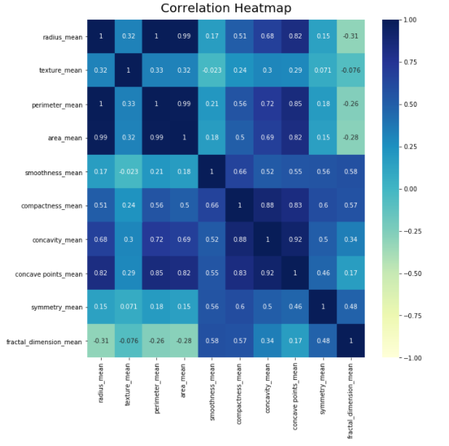

Slide 16
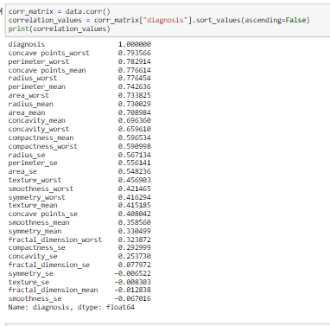
Finding Co-relation
2. using corr()

Slide 17
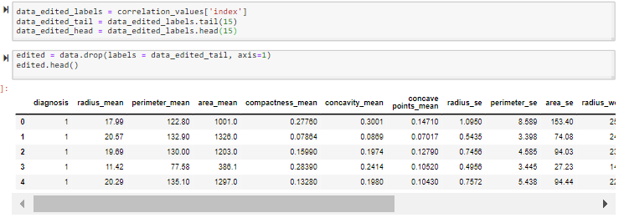
Why finding correlation is important?

Slide 18
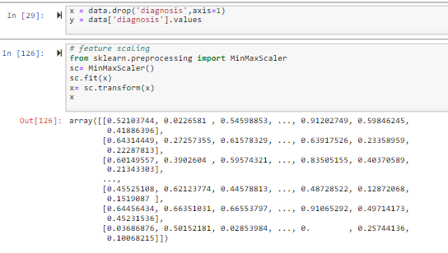
Feature scaling

Slide 19
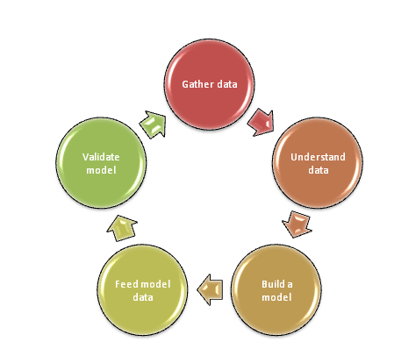
MODELLING & PREDICTION
Import Packages and functions
Get data to work with and, if appropriate, transform it
Create a classification model and train it with existing data
Evaluate your model to see if its performance is satisfactory
Apply your model to make predictions

Slide 20
Modelling methodology
Logistic Regression (LR)
Linear Discriminant Analysis (LDA)
K-Nearest Neighbors (KNN).
Classification and Regression Trees (CART).
Gaussian Naive Bayes (NB).
Support Vector Machines (SVM).

Slide 21
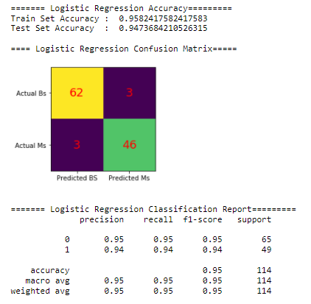
Logistic Regression (LR)

Slide 22
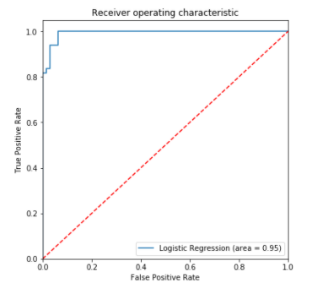
ROC curve

Slide 23
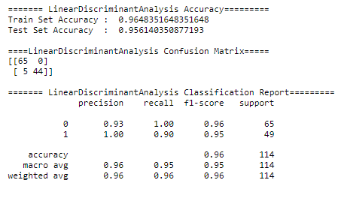
Linear Discriminant Analysis

Slide 24
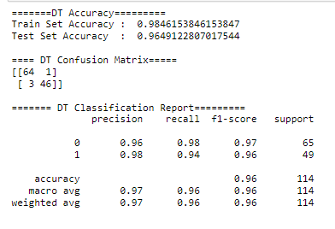
Decision Tree

Slide 25
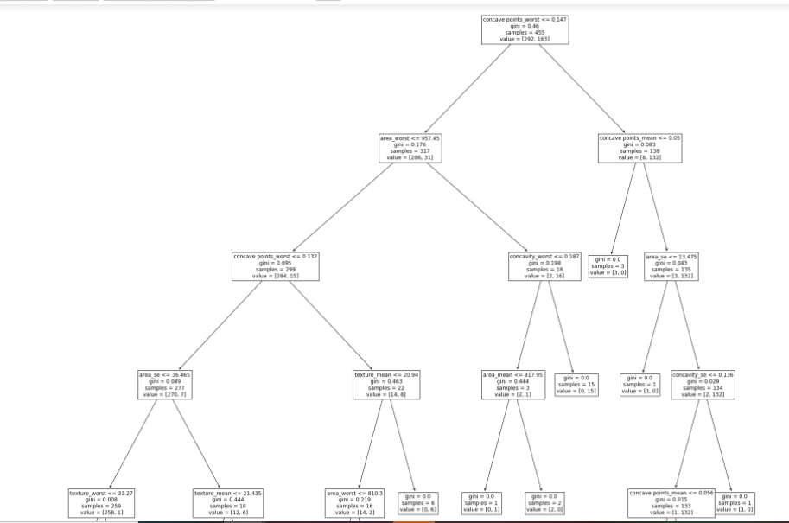
Decision Tree Plot

Slide 26
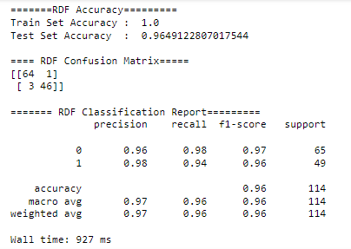
Random Forest Model

Slide 27
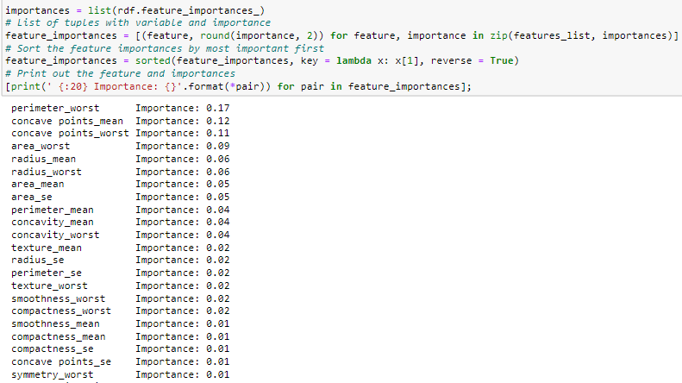
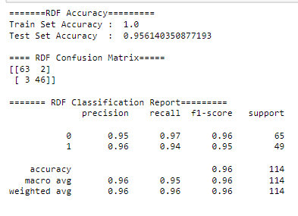
Feature Importances

Slide 28
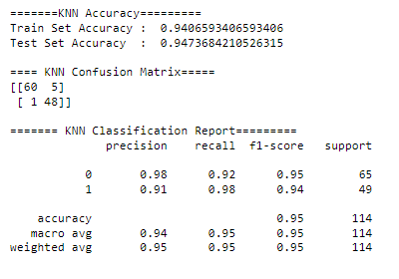
KNN

Slide 29
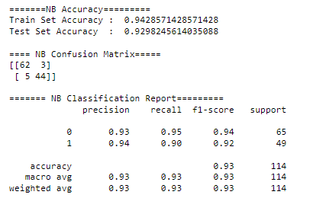
Gaussian Naive Bayes

Slide 30
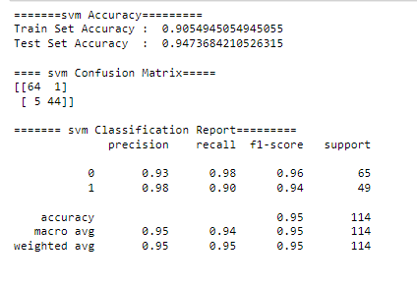
Support Vector Machine

Slide 31
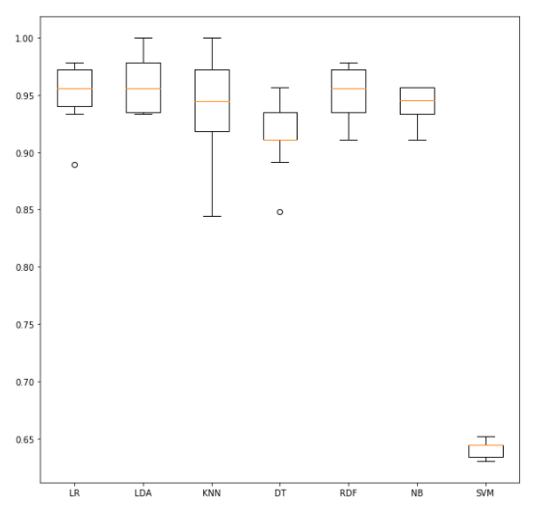
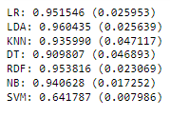
Algorithm Comparison

Slide 32
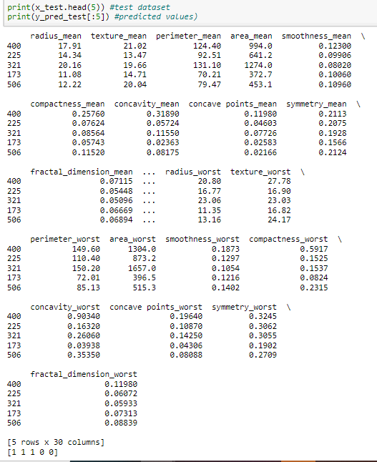
Results:

Slide 33
CONCLUSION
At the end of the project I had identified
What are the features that malignant tumors tend to have
Important underlying attributes thereby helping in predicting the stage of breast cancer depending on the values of these attributes
Predicted the tumors using six ML models and obtained 96% classifier accuracy for LDA

Slide 34
THANK YOU

